Slide 1
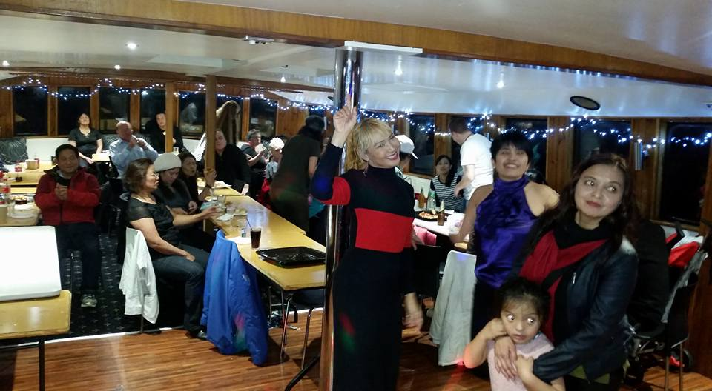
PRESENTATION Tuesday the 7th of June 2016
Karaoke – Disco – DJ’s – MC’s Kid’s Parties – Wedding & More
Call us on
0414 395 578

Slide 2
FMK Entertainments is an established business of 10+ years with operations in Sydney, the mid and northern NSW & S/East Queensland
FMK Entertainments has become one of the top suppliers for quality karaoke entertainment, we currently have regular weekly residential venues across two states, and we are equally proud of
our earnt reputation for the supply of superior professional entertainment services.
We only employ reliable responsive Hosts/MC’s totally focused on our customer needs, we then equipped them with all the latest up-to-date premium equipment including, but not limited to the latest software programs, computerised digital song library, professional lighting and promotional banners, cordless professional UHF microphones and an 18” inch LED singer song display monitor with fold back.

Slide 3
Our Team

Slide 4
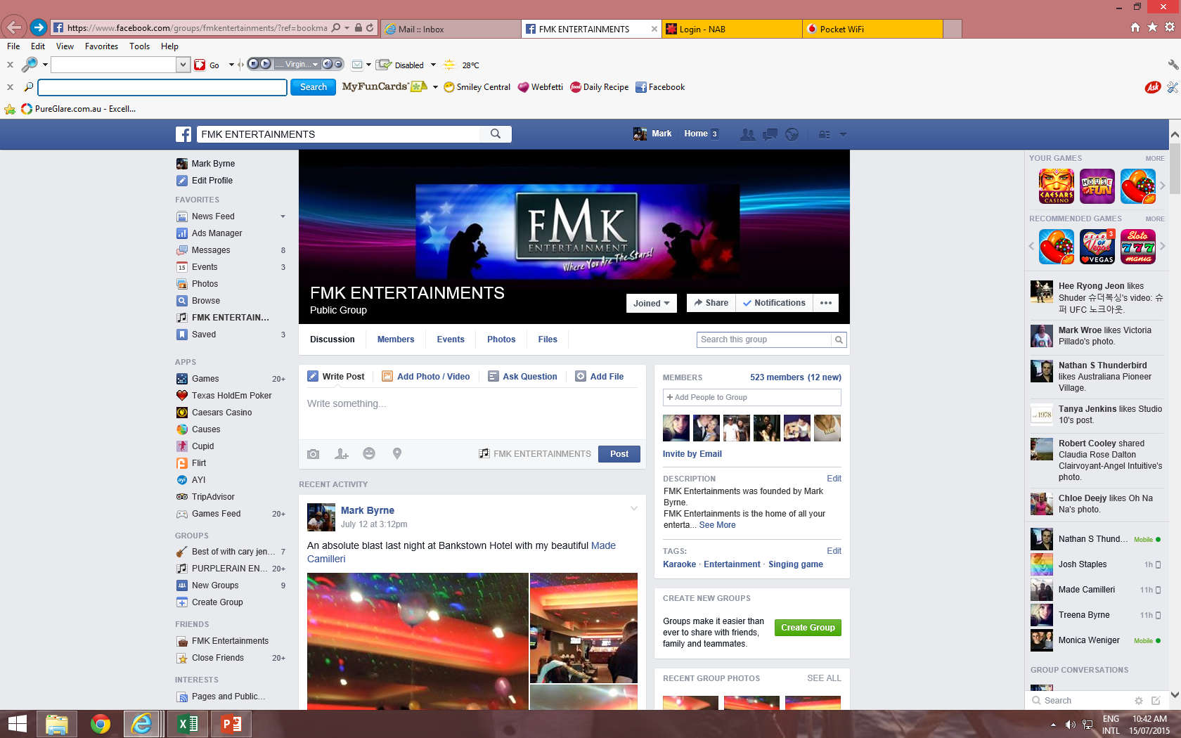
FMK Entertainments Social Media Website.
Over 800 followers!

Slide 5
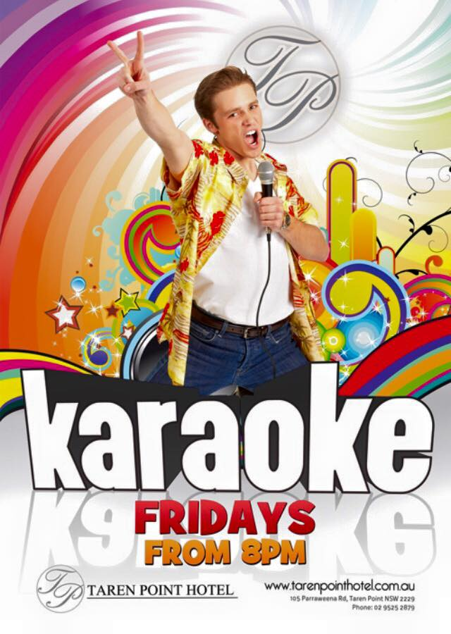
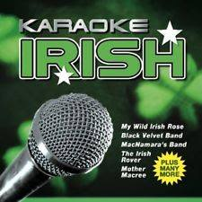

Slide 6
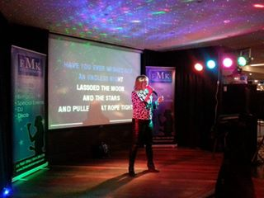
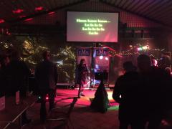
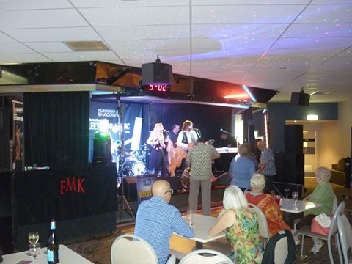
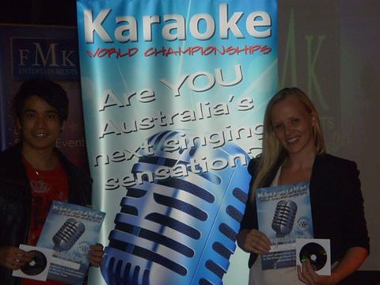
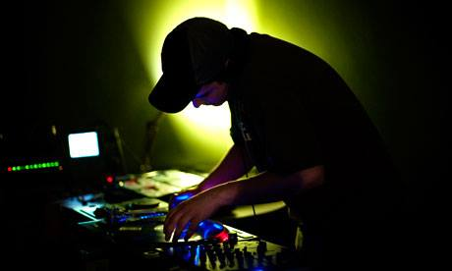

Slide 7
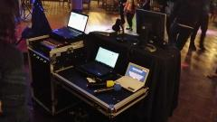
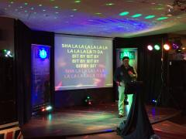
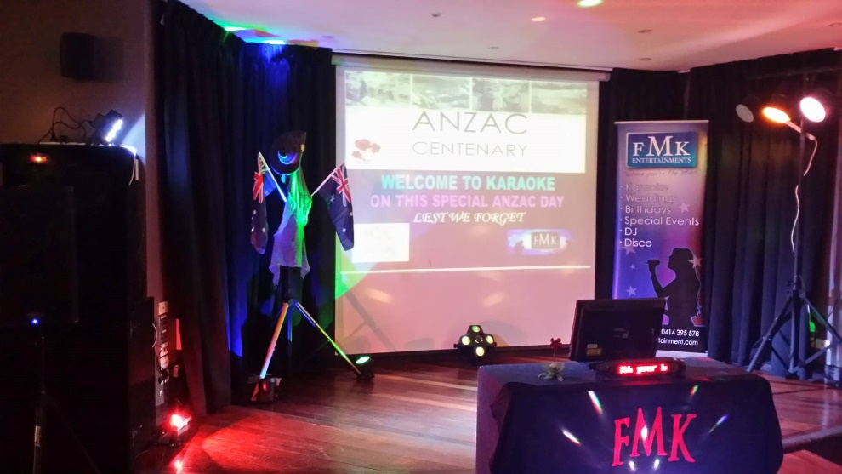

Slide 8
FMK Entertainments uses the Singer Karaoke Song Selector Touchscreen
With Over 100,000 Songs within our Data Base

Slide 9
Video Retro DJ Listen and Watch Video Hits

Slide 10
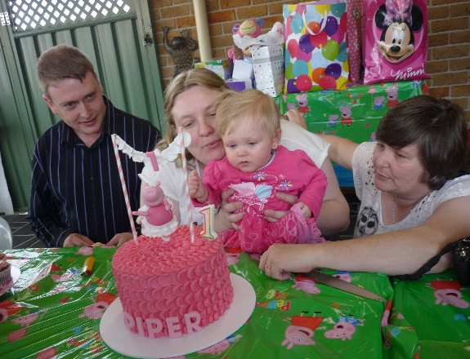
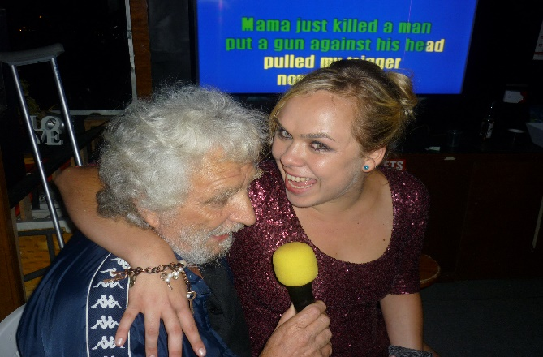
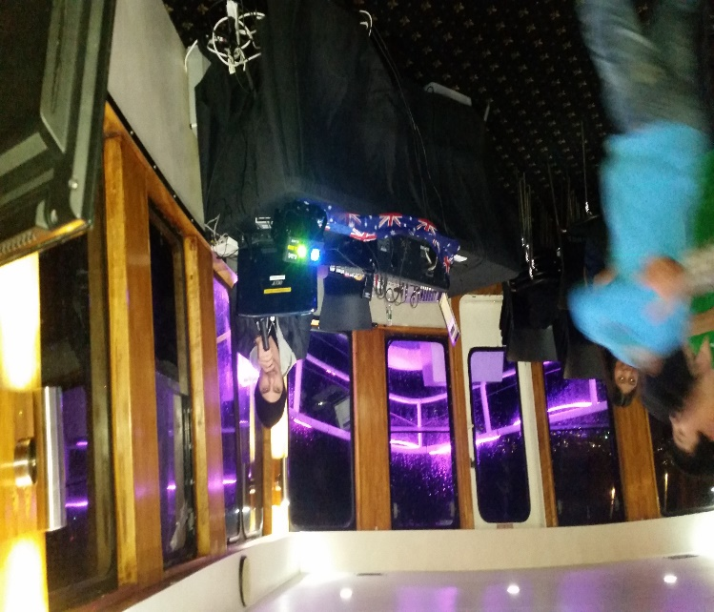
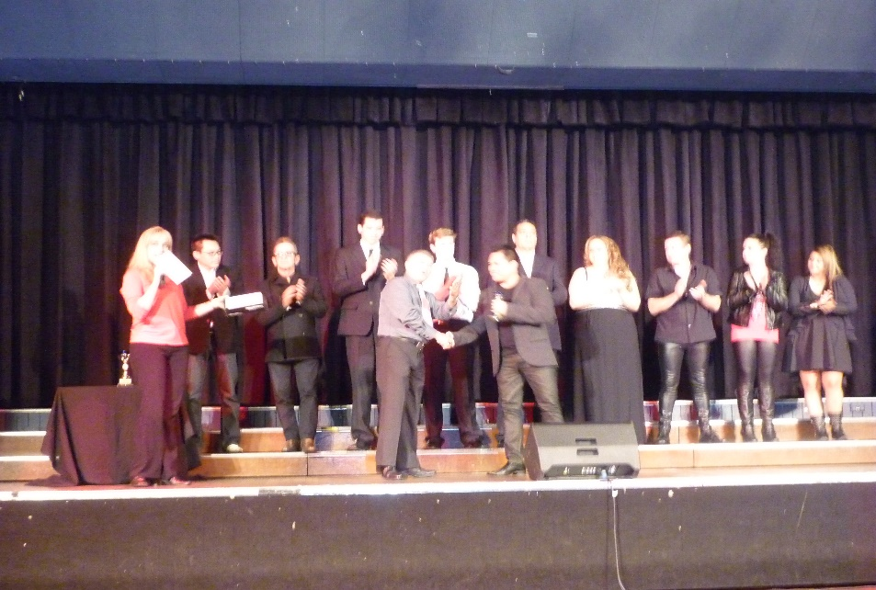
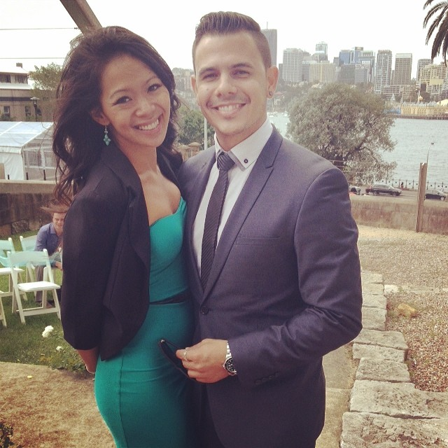
At FMK Entertainments we also Provide MC’s For Weddings, Special Functions and/or Milestone Events

Slide 11
We thank you for your time. Remember for all your Entertainment needs, look no further than us at FMK. We have you covered!

